Slide 3
OVERVIEW
360 Degree Mentorship Program is a developmental relationship. It exists between a person of greater experience (mentor) and a person of lesser experience (mentee). It is characterized by mutual trust and respect.
Our Mentor Program is designed to fill the gap in areas where expertise is desired and to develop networks between colleagues. Improves performance, personal/professional development, career progression, and morale.
Our mentoring process is to support participants in becoming more effective in their work environment. The focus is on the mentee’s learning needs and desired outcomes. Timely feedback and reflection through the asking of impactful questions are essential components in mentoring sessions.

Slide 4
4
www.mci-group.com

Slide 5
MENTORSHIP TOPICS MAY INCLUDE
All aspects of Urology Sub-Speciality
Professional Development focusing on skills & best clinical practice
Educational Development through regular updates in recent technology
Mentoring - The purpose of the mentoring process is to support participants in becoming more effective in their work environment.
Notes:
Angulation of instruments and Tactile sensation not as important with polar tumours with polar tumours

Slide 6
Benefits of a Mentorship Program
Extended Networking and Collaboration Skills
Immeasurable Transfer of Knowledge and Skills
Supporting the next generation of Urologists
Increased Organizational Commitment
Improved Retention
Succession Planning

Slide 7
Mentee Benefits
Acquire additional skills, knowledge, and abilities
Strengthen confidence
Better informed career planning and improved career progression
Become a more effective team member
Improved networking / access to influential people

Slide 8
PROGRAM STRUCTURE
This program is divided into 3 Phases to achieve the desired outcomes

Slide 9
Phase 1
Venue: Authorized training centers (TBD)
Duration: 2 – 3 Days
Content will include:
Theoretical and basic knowledge of the topic
Hands on training based on the content of different specialities
Dry lab
Simulators
Animal or cadaver activities
Attending a live surgery by expert in that field

Slide 10
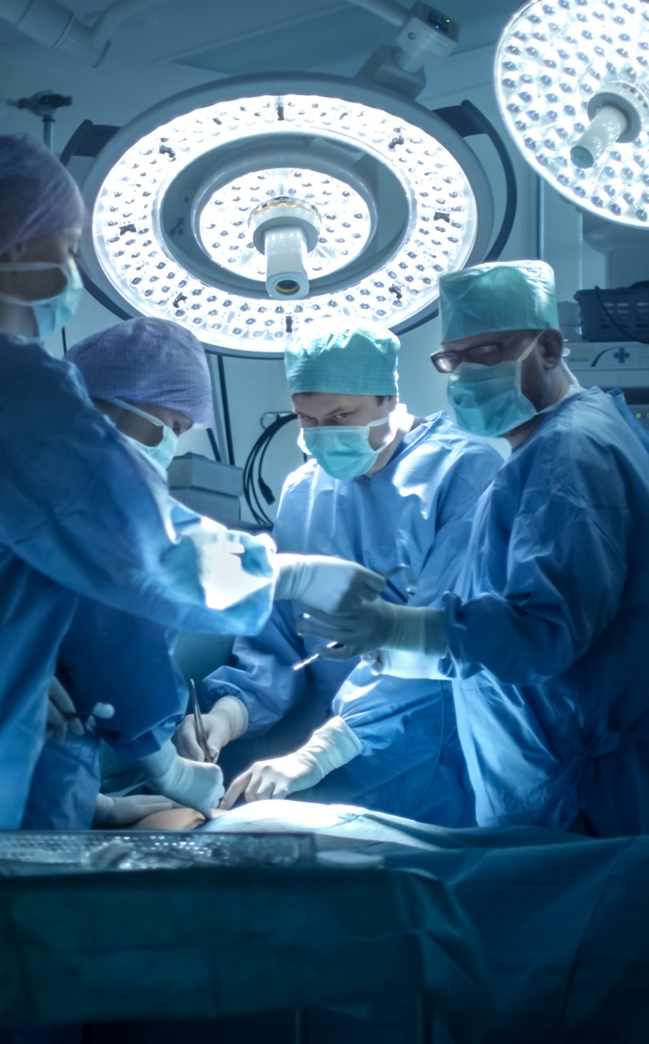
Phase 2
Duration: 2 Days
Venue: Home Country of each attendee
When the candidates goes back to their home country ASU will send an expert to assist him / her in the operating theatre for couple of cases.
ASU Mentor will ensure to provide attendee basic surgical skills that would help them in initiating independent surgeries

Slide 11
Phase 3
The candidate should do few cases under supervision of local mentor assigned by ASU
Cases to be recorded and submitted to the program director
At the end of three phases the candidate will be get a program completion certificate from ASU

Slide 12
How do I Become a Mentor?
To become a mentor, please send us your biodata, key areas of speciality and current country of residence – (Email ID of a person)
How do I apply for the mentorship program?
The attendee needs to be in the last years of the residency program
Priority will be given to AAU Active Members
We also are willing to welcome the first year fellowship students
Age Limit: Below 35 Years
Should submit the activity log book
Selection will be based on merits and first come first serve basis
Questions

Slide 13
What is the Time Commitment?
It is expected that the formal mentor-mentee relationship will last a minimum of 3 – 6 months
How is the Mentor Program Evaluated?
At the close of the mentoring process, both the mentor and the mentee individually complete a gap analysis test
AAU will partially support the activity keeping in mind the world bank classification based on income group
Questions

Slide 14
Amazing people don’t just happen, they are mentored!
Successful people never reach their goals alone!
14
www.mci-group.com

Slide 15
THANK YOU
Arab Association Of Urology
Arab School Of Urology
www.araburology.org
www. arabschoolofurology.com

